Slide 1
Analyzing Public Sentiment on Ongoing Political Campaigns in the US using Reddit Data
Raga Naga Sowmya Eemani (SUID: 4661761732) Vineeth Reddy Beeram (SUID: 8981993902) Vinithra Sadras (SUID: 261698528) Dileep Kumar Perala (SUID: 224652517)

Slide 2
Introduction

Slide 3
Motivation
Social media platforms significantly help people express their opinions.
Real-time sentiment analysis on Social media data can help political leaders quickly understand public opinions and refine their election strategies accordingly.
We are trying to analyse Reddit data to see how quickly political opinions change, helping leaders stay updated with voter sentiment.

Slide 4
Objective
Collect and analyse Reddit posts on five politicians, comparing sentiments in the top 200 trending posts and posts from the previous month.
Classify them into positive, negative, or neutral categories.
Analyse and compare the scores of politicians.

Slide 5
Description
Gathered and visually represented sentiment data from Reddit discussions using Python Reddit API Wrapper (PRAW) and WordCloud respectively.
Conducted text analysis with polarity and subjectivity measures using textBlob.
Analyzed data to reveal public opinion on each politician.

Slide 6
Implementation

Slide 7
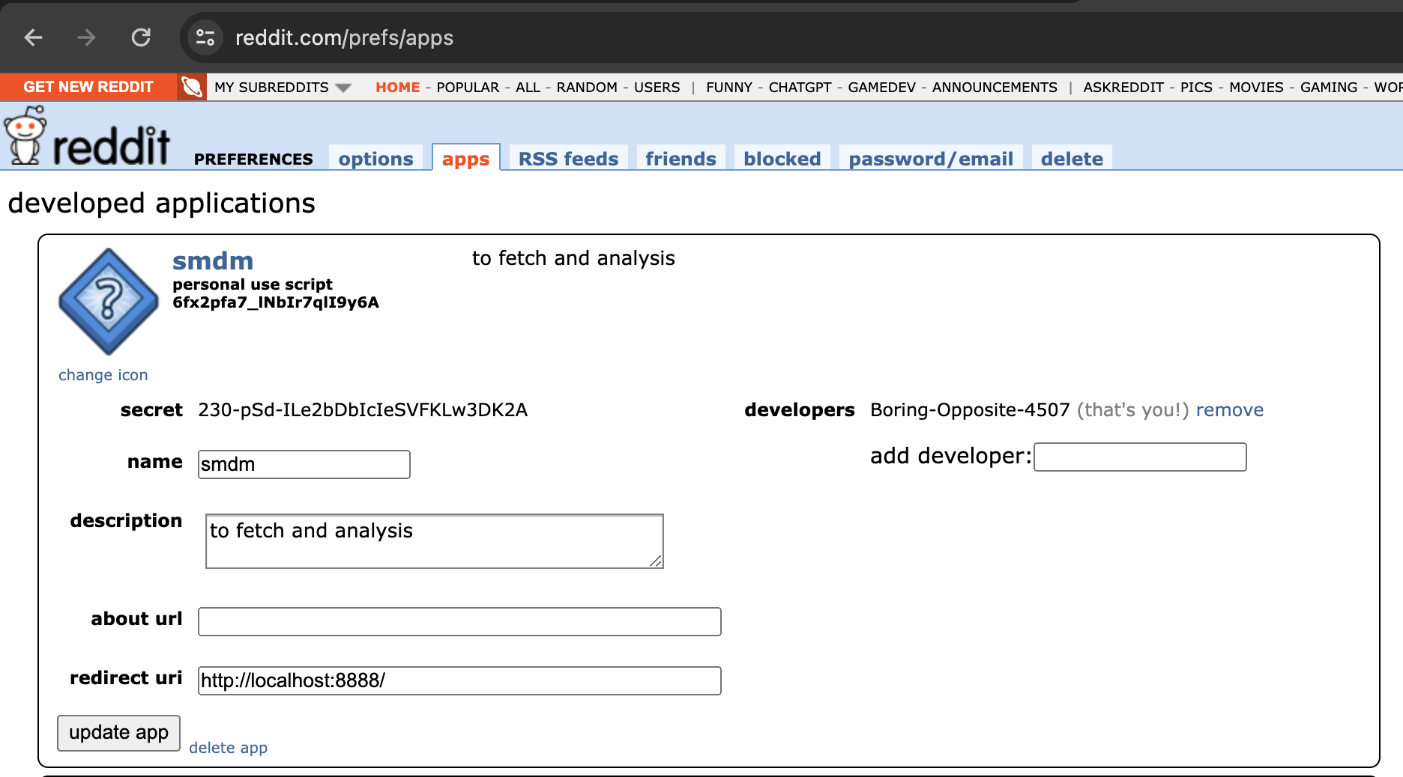
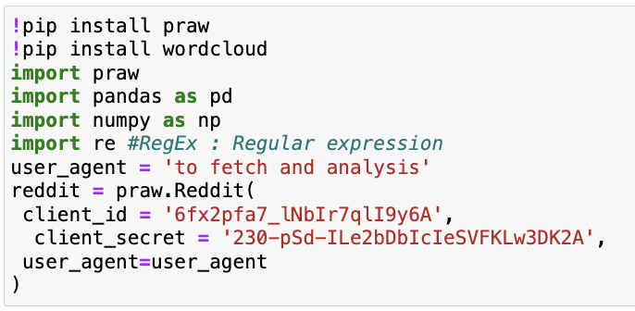
Reddit API connection

Slide 8
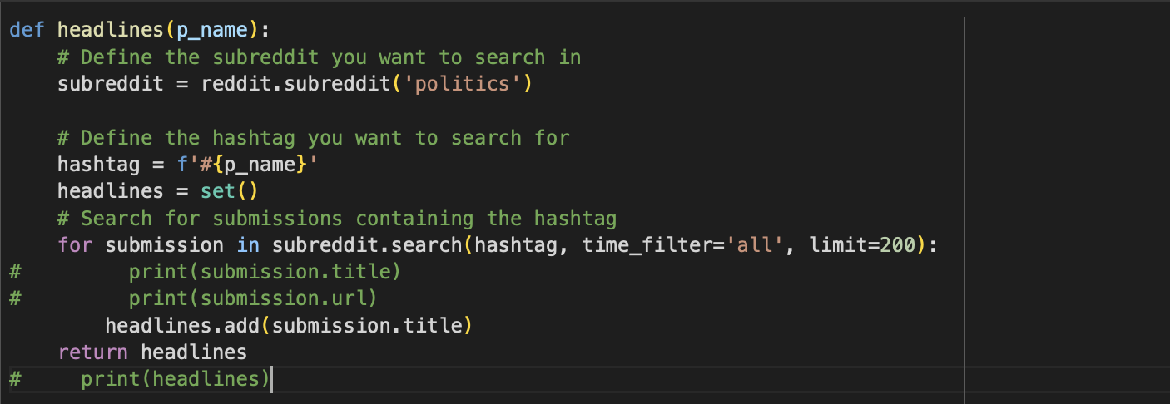
Data fetching for trending 200 posts

Slide 9
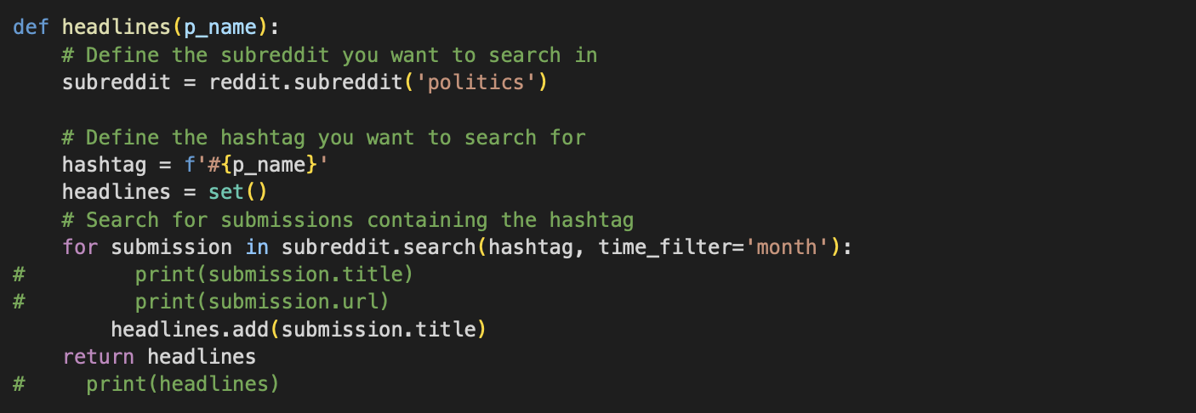
Data fetching for last 30 days

Slide 10
DataFrame Size of Prev Month
 | #Posts in last month
BIDEN | 100
TRUMP | 100
KENNEDY | 40
WEST | 19
STEIN | 5

Slide 11
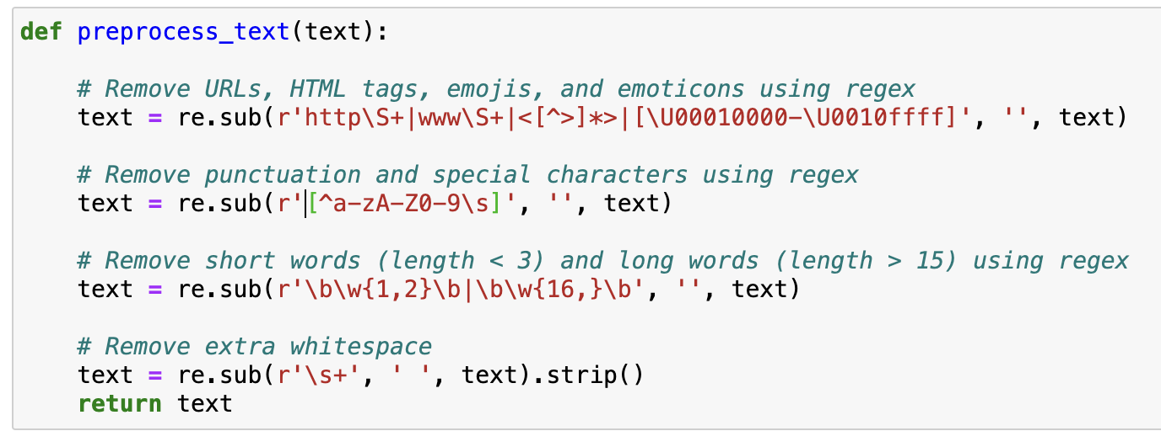
Data pre-processing

Slide 12
Visualization

Slide 13
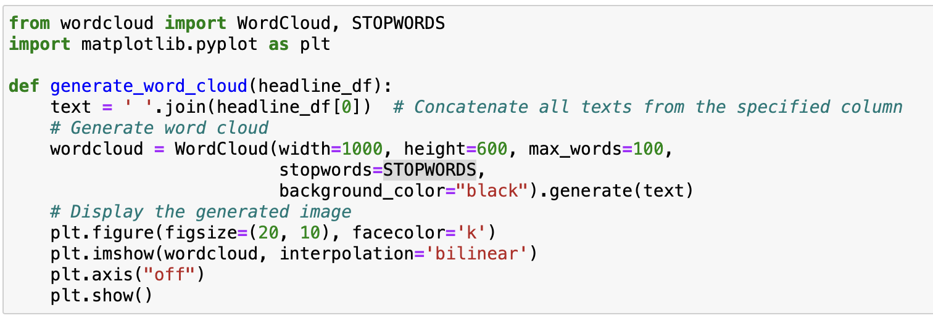
WordCloud

Slide 14
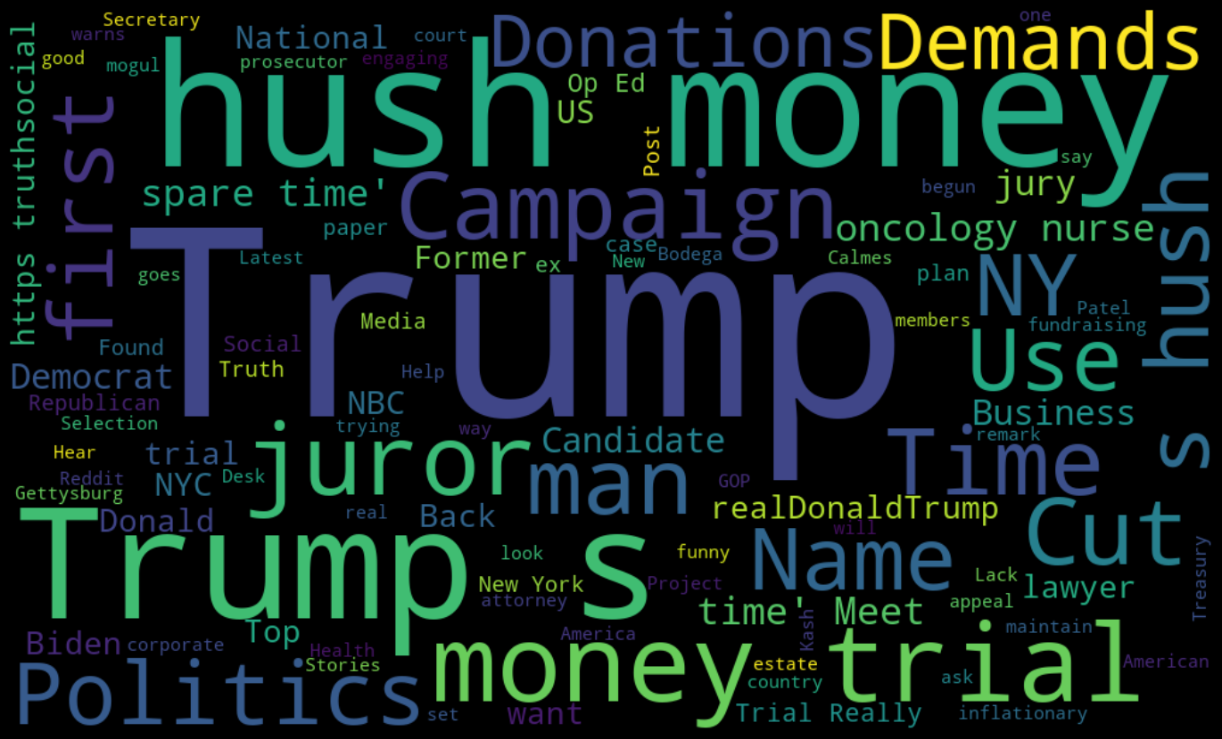
WordCloud for Reddit posts related to Trump

Slide 15
Text Analysis

Slide 16
Text analysis parameters
Subjectivity: Subjectivity quantifies the amount of personal opinion and factual information contained in the text. - The higher subjectivity means that the text contains personal opinion rather than factual information.
Polarity: Polarity refers to the overall sentiment conveyed by a particular text, phrase or word. - The higher subjectivity means that the text contains personal opinion rather than factual information.

Slide 17
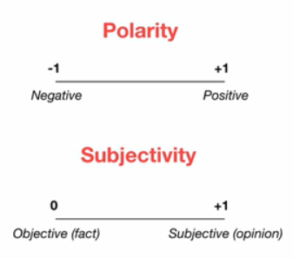
Text analysis

Slide 18
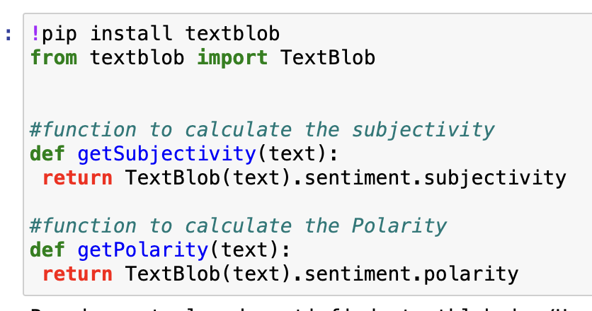
Text analysis

Slide 19
Results

Slide 20
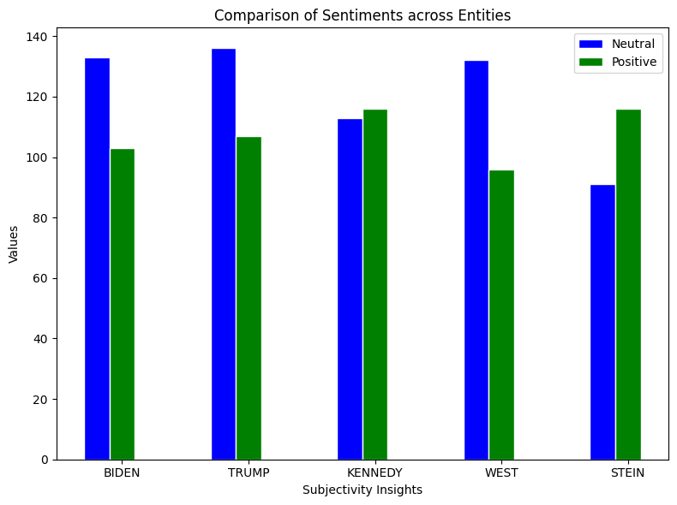
Subjectivity Results Top 200 Posts vs Previous Month

Slide 21
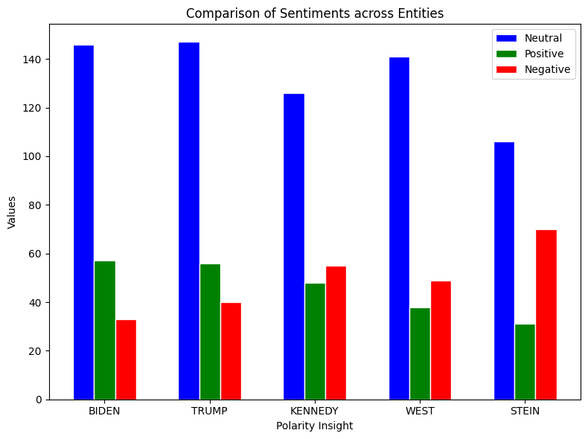
Polarity Results Top 200 Posts vs Previous Month

Slide 22
Subjectivity Results
TOP 200 POSTS | NEUTRAL (GENERAL STATEMENTS) | POSITIVE (OPINION)
BIDEN | 36.66% | 63.33%
TRUMP | 41.66 | 58.33
KENNEDY | 53.39 | 46.60
WEST | 56.32 | 43.67
STEIN | 69.30 | 30.69
LAST MONTH | NEUTRAL (GENERAL STATEMENTS) | POSITIVE (OPINION)
BIDEN | 51% | 49%
TRUMP | 50% | 50%
KENNEDY | 65% | 35%
WEST | 57.89% | 42.10%
STEIN | 60% | 40%

Slide 23
Polarity Results:
TOP 200 POSTS | NEUTRAL | POSITIVE | NEGATIVE
BIDEN | 61.86% | 24.15% | 13.98
TRUMP | 60.49 | 23.04 | 16.46
KENNEDY | 55.02 | 20.96 | 24.01
WEST | 61.84 | 16.66 | 21.49
STEIN | 51.20 | 14.97 | 33.81
LAST MONTH | NEUTRAL | POSITIVE | NEGATIVE
BIDEN | 58% | 24% | 18%
TRUMP | 58% | 19% | 23%
KENNEDY | 70% | 5% | 25%
WEST | 68.42% | 15.78% | 15.78%
STEIN | 100% | 0% | 0%

Slide 24
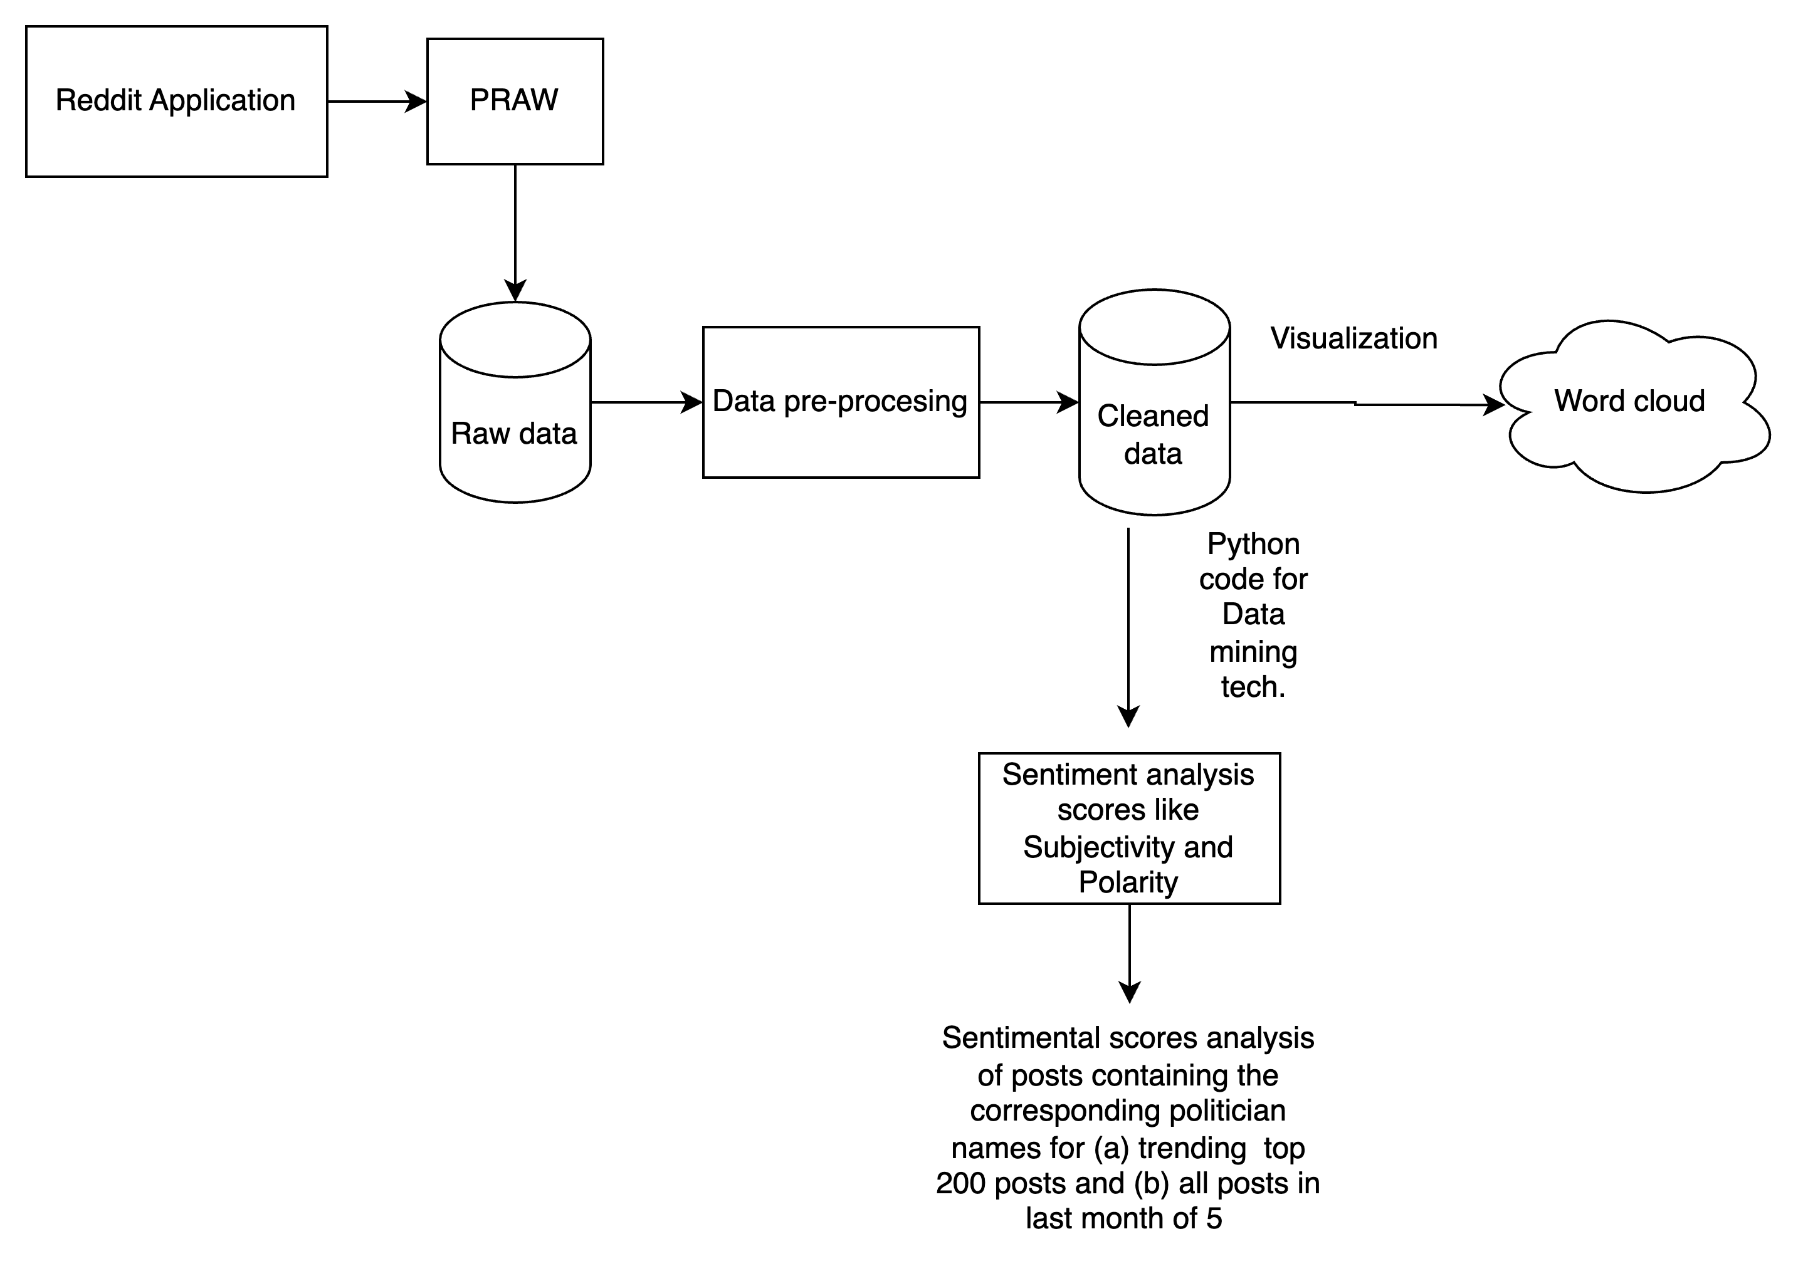
Conclusion

Slide 25
Our project is able to..!
Connect and fetch raw reddit posts about a particular politician.
Clean the data using data-processing techniques.
Use the cleaned data to do the frequency analysis of word.
Use the cleaned data to find the sentiment scores of each post of each politician.
Visualise and compare the sentiment scores of them in past 30 days and trending 200 posts.
Make meaningful insights based on the comparison.

Slide 26
Thankyou!!

